Slide 1
AIM: How did the Delhi Sultanate and Seljuk Turks demonstrate continuities and changes in terms of governance, the spread of religion and cuture and military actions with empires from 1000-1450?
DO-NOW
WRITE A HISTORICAL CONTEXT WHICH SUMMARIZES HOW EMPIRES GOVERNED, SPREAD CULTURE AND USED THEIR MILITARIES FROM 1000-1450.
WRITE THIS ON A SEPARATE SHEET OF PAPER!

Slide 2
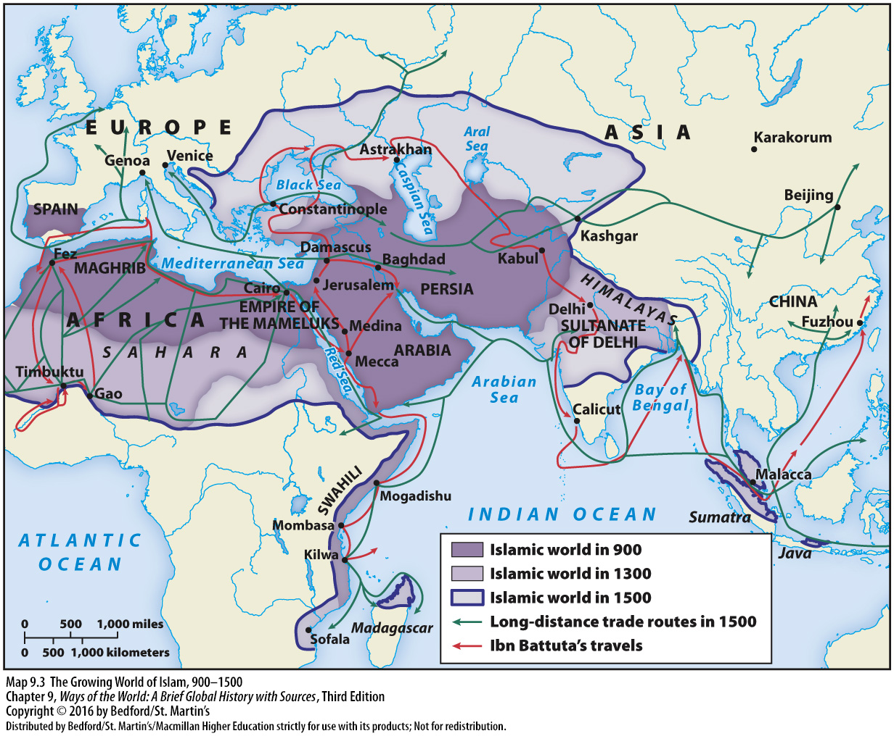

Slide 3
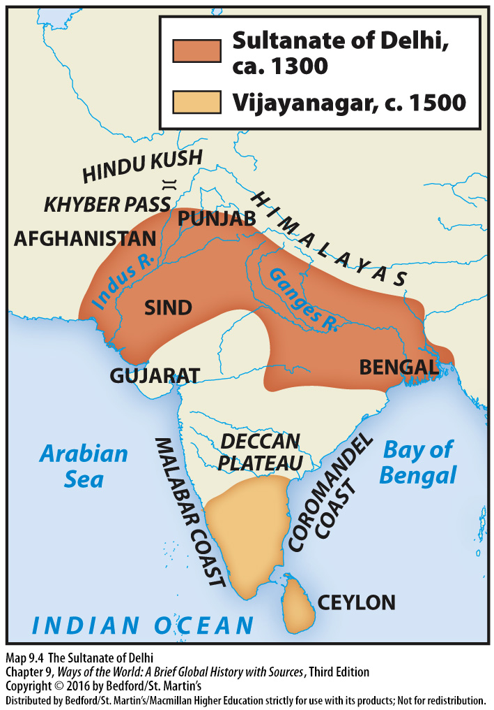
What do we know about the Delhi Sultanate?

Slide 5
DELHI SULTANATE-DEMOGRAPHICS
The Indian population had largely been stagnant at 75 million during the Middle Kingdoms era from 1 AD to 1000 AD.
During the Medieval Delhi Sultanate era from 1000 to 1500, India experienced lasting population growth for the first time in a thousand years, with its population increasing nearly 50% to 110 million by 1500 AD

Slide 6
DELHI SULTANATE-ECONOMY
Islamic civilization was the most cosmopolitan civilization of the Middle Ages
It had a multicultural and pluralistic society, and wide-ranging international networks
While initially disruptive due to the passing of power from native Indian elites to Turkic Muslim elites, the Delhi Sultanate was responsible for integrating the Indian subcontinent into a growing world system
between 1000 and 1500, India's GDP grew nearly 80% up to $60.5 billion in 1500.
it was not as sophisticated as the Islamic world or China in terms of mechanical technology
The Delhi Sultanate was largely responsible for the spread of papermaking from the Islamic world to the Indian subcontinent

Slide 7
DELHI SULTANATE-ECONOMY
it was not as sophisticated as the Islamic world or China in terms of mechanical technology
The Delhi Sultanate was largely responsible for the spread of papermaking from the Islamic world to the Indian subcontinent
It was also during the Delhi Sultanate period that the spinning wheel spread across the Indian subcontinent.
The diffusion of the spinning wheel, and the incorporation of the worm gear and crank handle into the roller cotton gin, led to greatly expanded Indian cotton textile production

Slide 8
DELHI SULTANATE-CULTURE
Muslim invasion was different from other invasions
he successful Muslim conquerors retained their Islamic identity and created new legal and administrative systems that challenged and usually in many cases superseded the existing systems
even influencing the non-Muslim rivals and common masses to a large extent, though the non-Muslim population was left to their own laws and customs
Creation of the Hindustani language which was a mixture of Arabic and traditional languages

Slide 9
This is a picture of Qutb minar (Qutub Minar).

Slide 10
STOP AND JOT
How did the use of monumental architecture show continuities and changes in the Southeast Asian Empires to the Indian subcontinent from 1000-1450?
How did the use of technology by governments show continuities and changes in East Asia to the Indian subcontinent from 1000-1450?

Slide 11
DELHI SULTANATE-MILITARY
The bulk of Delhi Sultanate's army consisted of nomadic Turkic Mamluk military slaves, who were skilled in nomadic cavalry warfare
The Delhi Sultanate's Mamluk army were skilled in the same style of nomadic cavalry warfare used by the Mongols, making them successful in repelling the Mongol invasions

Slide 12
DELHI SULTANATE-TEMPLE DESECRATION
37 instances of Hindu temples being desecrated or destroyed in India during the Delhi Sultanate, from 1234 to 1518, for which reasonable evidences are available.
this was not unusual in medieval India, as there were numerous recorded instances of temple desecration by Hindu and Buddhist kings against rival Indian kingdoms between 642 and 1520, involving conflict between devotees of different Hindu deities, as well as between Hindus, Buddhists and Jains.
there were also many instances of Delhi sultans, who often had Hindu ministers, ordering the protection, maintenance and repairing of temples, according to both Muslim and Hindu sources
In certain cases, the Sultanate would grant a permit for repairs and construction of temples if the patron or religious community paid jizya (fee, tax).

Slide 13
STOP AND JOT
How did temple desecration show continuities and changes from East Asia to the Indian subcontinent from 1000-1450?
How did cultural diffusion show continuities and changes from East Asia to the Indian subcontinent from 1000-1450?

Slide 15
HISTORICAL CONTEXT OF SELJUKS You can take notes here

Slide 19
STOP AND JOT
Provide a historical context of Dar-al Islam from 600-1200.

Slide 20
SELJUK DYNASTY-GOVERNMENT
The Seljuk empire was founded by Tughril Beg (990–1063) and his brother Chaghri Beg (989–1060) in 1037
The Seljuk rule was modelled after the tribal organization common in Turkic and Mongol nomads and resembled a 'family federation' or 'appanage state’
The Seljuks defeated the Persians and began moving westward and took over Baghdad, then the capital of the Islamic caliphate, in 1055.

Slide 21
SELJUKS VS. BYZANTINES
“In the previous age” the Byzantines “had thrust deep into the heart of Islam, had conquered a good deal of Syria and annexed Armenia to the Empire. But the Byzantine revival had now spent itself
“The Turks drove towards the Byzantine frontiers, partly by design, partly by accident.
When the Seljuks went into areas of the Byzantine and areas of Abbasid rule, they were viewed as savages
“When Tughril died childless in 1063, the Sultanate passed to his nephew Alp Arslan ('hero lion'), Chagri's son, who was probably anxious to divert the stream of nomadic violence away from the lands of Islam towards Christendom and at the same time to win glory as a ghazi, or champion of the faith.

Slide 22
Seljuk Alp Arslan humiliating the Byzantine Emporer Romanus

Slide 23
SELJUKS BEGIN TO FALL
Within ten years of the Battle of Manzikert, the Seljuks had won control of most of Anatolia.
Although successful in the west, the Seljuk sultanate in Baghdad reeled under attacks from the Mongols in the east and was unable--indeed unwilling--to exert its authority directly in Anatolia.
When Badr died in 1094, a few months before the aged Caliph, Seljuk hopes of restoring Egypt to orthodoxy had been frustrated, and the rival parties were still struggling for the control of Syria, a situation highly advantageous to the Latin Crusaders who broke into the Levant three or four years later.

Slide 24
SELJUKS BEGIN TO FALL
The greatest threat to Seljuk rule came from radical Sufis and Shiites, who had became disillusioned by the corruption of the Fatimid empire and remained disillusioned under the Seljuk.
The most powerful and radical of these Sufi sects were the Ismaili, also known as the Assassins, a medieval terrorist groups the seized Seljuk strongholds, and murdering leading amirs
In end it made ordinary people suspicious of not only the Ismaelis but also Shiite Muslims and Sufis.
When Hasan gave the word one young follower slit his own throat and another threw himself of the fortress walls to his death. Hasan said that he had 60,000 other men who prepared to the same: Sanjar showed good judgment, many would agree, by signing the peace treaty."

Slide 25
SELJUKS-THE SUCCESSES AND FAILURES
SUCCESSES | FAILURES
brought a new vigour and unity into Western Asia dealt a staggering blow to Byzantine power by winning Asia Minor for Islam, a feat the Arabs had never been able to achieve breaking down the last defences of Christendom on the Asiatic continent, and opening up this ancient land to Turkish colonial settlement They checked the spread of terrorist activities through their orthodoxy in Islam madrasas or 'college-mosques' were founded in the principal cities for the instruction of students in fikh (Islamic jurisprudence | proved unable to create a strong, durable and centralized Empire conceptions of government were primitive, and despite the efforts of Nizam al-Mulk to instruct them in the principles of ancient Persian despotism they treated their realm as family property to be divided up among sons and nephews, who if minors were entrusted to the care of atabegs ('father-chiefs’) struggles for the succession further weakened the Empire and gave the Abbasid Caliphs a chance to recover some of their power

Slide 26
STOP AND JOT
How did the Seljuk Empire bring changes to Dar-al Islam.
Explain how the collapse of government saw continuities and changes in East Asia and Dar-al Islam from 1000-1450.

